Slide 1
Created By: Mohammad Shahoud
Online Judges, Adhoc, Greedy

Slide 2
The Problem
Every problem has:
1 – Text
2 – Input
3 – Output
4 – Sample input (1 or more)
5 – Sample output (1 or more)
Be careful about the restrictions on the input and output

Slide 3
Judge Response
Accepted
Wrong Answer
Time Limit Exceeded
Runtime Error
Compilation Error
Presentation Error (ACM contests)

Slide 4
Online Judges
1 – Codeforces
2 – Topcoder
3 – Uva online judge
4 – Spoj
5 – A2oj

Slide 5
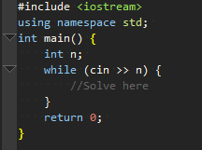
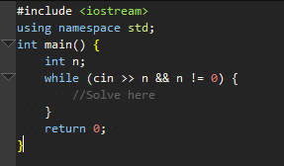
I/O in C++
1 - Read until the end of input.
2 – Read until `n` = 0
(1) (2)

Slide 6
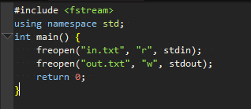
I/O with files
Reading & Writing from/to files:

Slide 7
Adhoc Problems
Adhoc generally signifies a solution designed for a specific problem or task, non-generalizable.
Usually they’re easy problems
No algorithms needed to solve ☺

Slide 8
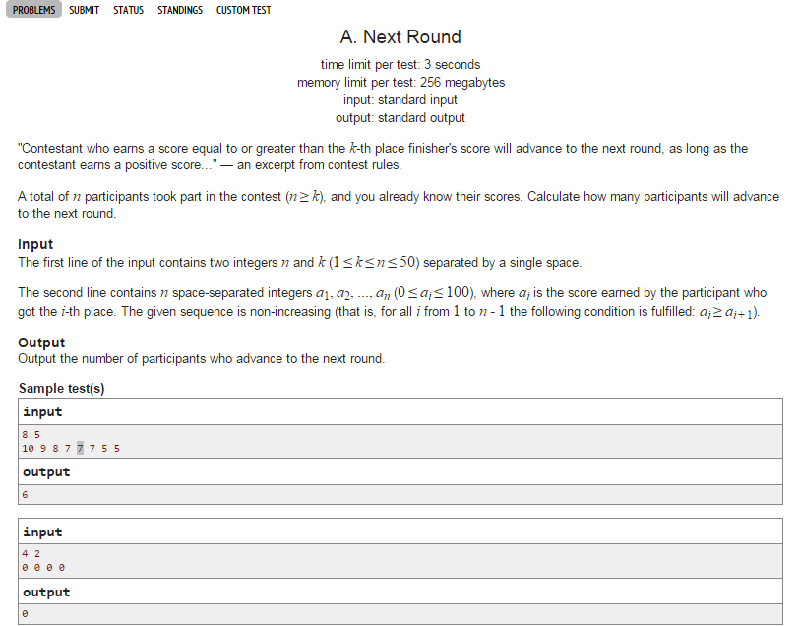

Slide 9
Greedy Algorithms
Do locally optimal choice at each stage with the hope of finding a global optimum.
Usually greedy algorithms are easy to implement and most of the time are quite efficient.

Slide 10
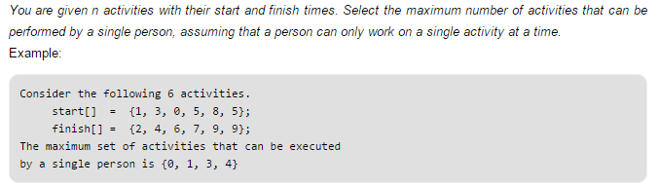
Activity Selection Problem

Slide 11
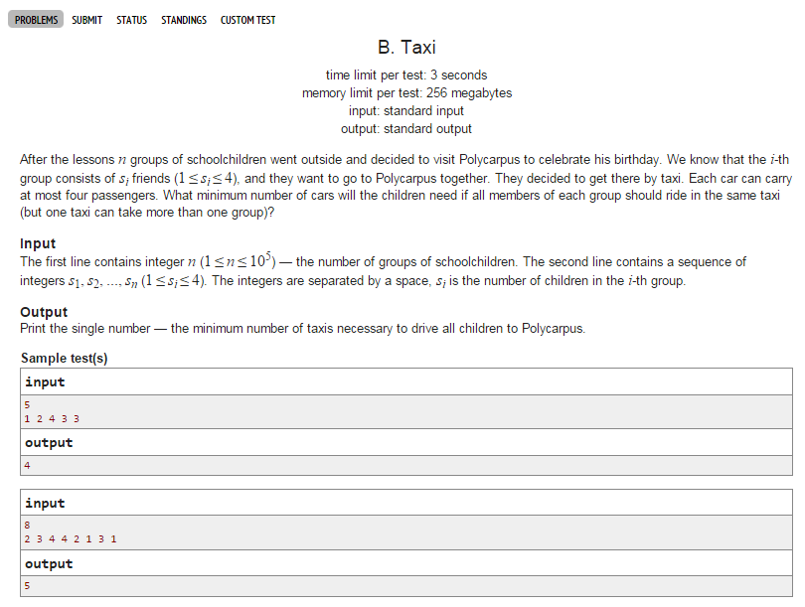

Slide 12
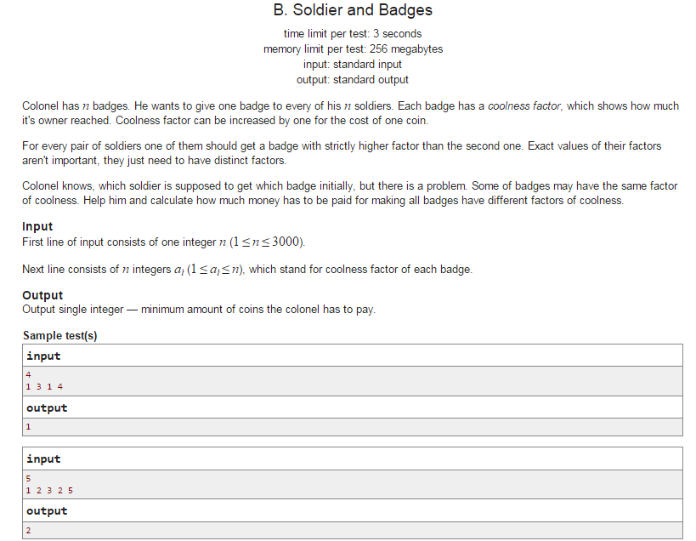

Slide 13
Another Problem?
Given `n` integers, find the length of the longest increasing subsequence such that all elements of the subsequence are sorted in increasing order.
{ 7, 8, 2, 4, 7, 9 }
Answer: 4 {2, 4, 7, 9}
{2, 7, 1, 9}
Answer: 3 {2, 7, 9}
Greedy will not work!

Slide 14
Problems To Practice
Adhoc: http://codeforces.com/problemset/problem/118/A
http://codeforces.com/problemset/problem/131/A
Greedy:
http://codeforces.com/problemset/problem/439/B
http://codeforces.com/problemset/problem/246/B
http://codeforces.com/problemset/problem/584/C

